Slide 1


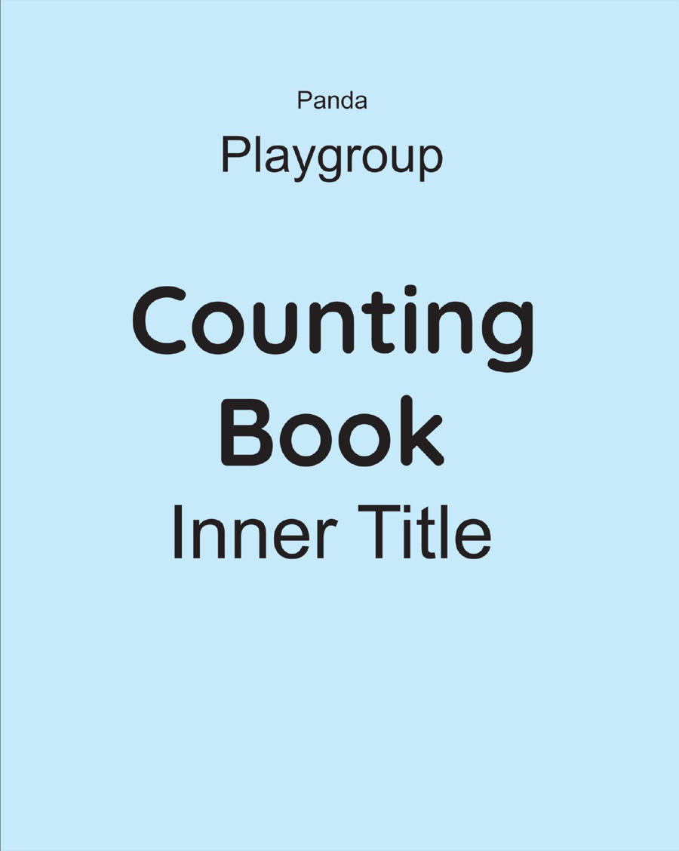
Panda Counting Book
Playgroup • Age 3+
An activity-based early-years book from the Panda Series.
A Project of Azhar Publishers & Book Factory

Slide 2
i
What's Inside
Panda Counting Book Playgroup • Age 3+
1
Numbers 1 to 20 with themed pictures
2
Tracing, counting and matching
3
Count, colour and find the number
4
Concepts: big / small, more / less, full / empty
5
Shapes, time and sorting
6
Dot-to-dots and revision

Slide 3
★
Purpose & Classroom Support
Introduces first numbers, counting and early concepts in a gentle, picture-led way for our youngest learners.
“
Every book comes with
1
2
3
Teacher's Lesson Plan
Practice Papers
Digital Interactive Version
A 40-week lesson plan that guides teachers, day by day.
Monthly tests and term exam papers for children to attempt.
An interactive flipbook and digital exercises for engaging, screen-based practice.
A Project of Azhar Publishers & Book Factory

